Slide 1
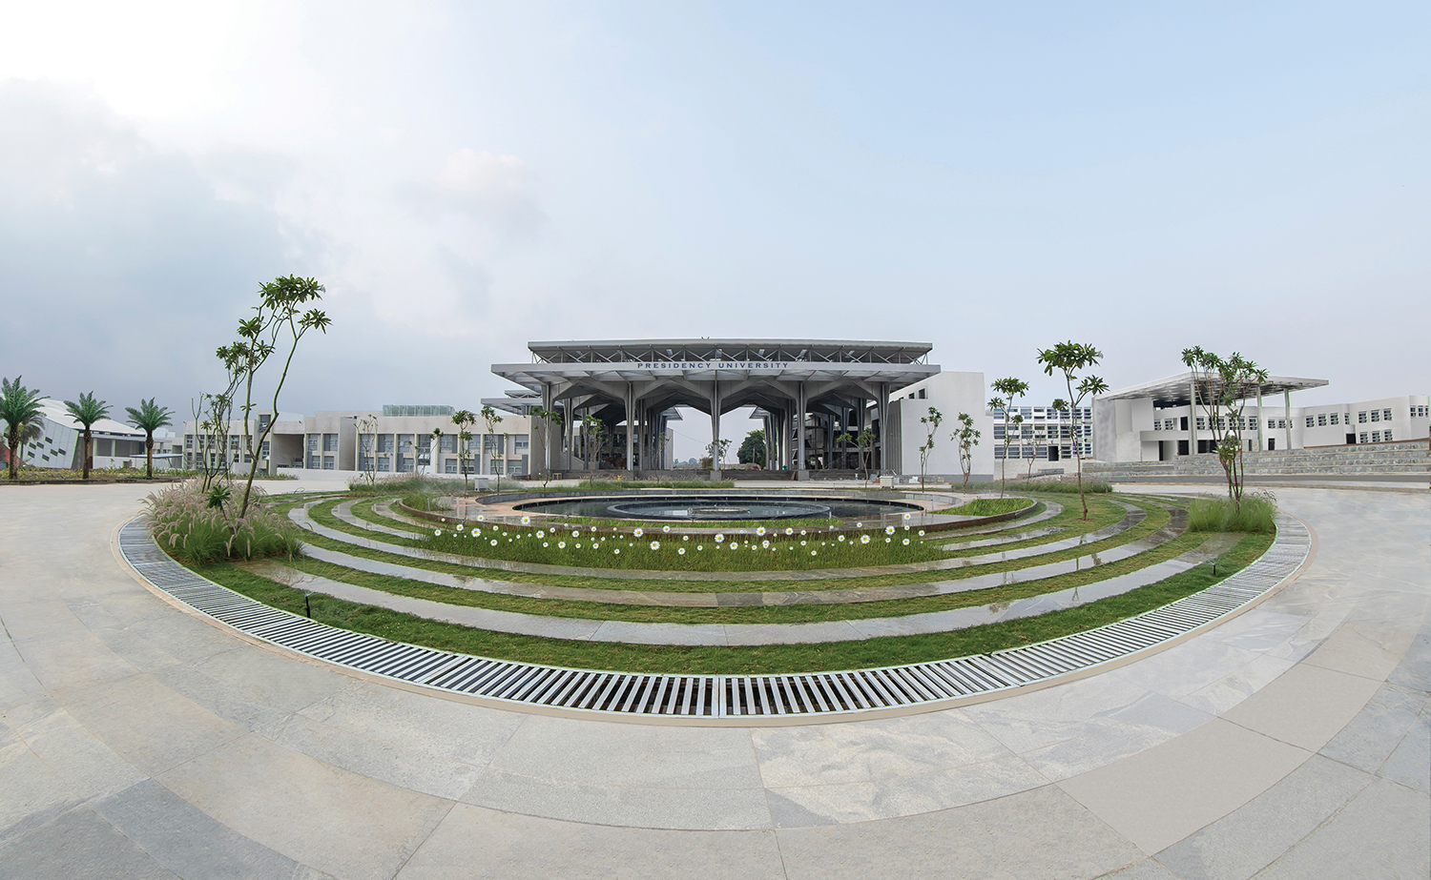

Mini Project (CSE7102)
REVIEW-2
29-08-2026
Presidency
School of Computer Science and Engineering

Slide 2
Camera-Based Automated Public Lighting with Motion Detection and Zone-Based Adaptive Control Using ESP32-CAM
CSS7102- Mini Project Review-2
Project ID: PRJ_306
Panel No:18
Group members details:
Under the Supervision of,
Mr.Mohaideen A
Assistant Professor
School of Computer Science and Engineering
Presidency University
Sl.No | Student Name | Roll Number
1 | Murali M Naik | 20241CSE3011
2 | Tejas H M | 20231CSE0211
3 | Mohith B E | 20231CSE0248
Name of the Program: Computer Science and Engineering
Name of the HoD : Dr. Asif Mohammed
Name of the Program Project Coordinator: Dr. Jayavadivel Ravi
Name of the School Project Coordinators: Mr. Muthuraju V

Slide 3
INDEX
Problem statement
Objectives
Literature/research understanding
Methodology and architecture
Implementation progress
Individual contribution

Slide 4
Problem Statement
Problem Statement No. | Category | Technologies Used
PRJ_306 | Hardware & Software | Artificial Intelligence, ESP32, Cloud Computing
Problem Description
Conventional public lighting systems typically operate on rigid timer schedules or basic sensor-based switching, leaving streetlights fully illuminated long after traffic has cleared. This static approach leads to excessive energy waste, poor adaptability to live traffic flow, and a lack of real-time visibility across distributed lighting infrastructure.
This work presents an automated public lighting system designed to detect road activity using embedded intelligence and targeted sensing. The node maintains a low-power standby state during quiet periods, immediately ramps up brightness in active zones upon detecting movement, and smoothly dims trailing lights behind moving targets. To complement edge-level control, cloud-based data logging provides system-wide visibility, long-term operational analytics, and scalable remote monitoring.
Performance
Improve responsiveness, reliability and operational efficiency of public lighting.
Security
Support secure system operation, reliable communication and protection against unauthorized access.
Scalability
Design so the solution can expand from prototype to multiple units and locations.
Automation
Reduce manual operation by enabling lighting to respond automatically to relevant conditions.
Difficulty Level: Medium

Slide 5
Objectives
To detect vehicles and pedestrians using camera/sensor inputs and identify the lighting zone requiring illumination.
To automatically control LED street-light intensity according to ambient light conditions and detected road activity.
To reduce unnecessary energy consumption by maintaining low-intensity standby lighting and increasing brightness only in the required zone.
To implement ESP32-based adaptive lighting control that increases brightness in the detected zone and gradually reduces lighting after the moving object passes.
To enable cloud-based monitoring and data storage of lighting and activity information for system monitoring, analysis, and future scalability.

Slide 6
Literature Review
Study | Technology / Focus | Key Findings | Limitation / Opportunity
Lau et al., 2015 | Traffic-based smart lighting using sensors | Detects vehicles/people and automatically changes light brightness. | Mainly tested in simulation; needs a real AI-based prototype.
Abdullah et al., 2019 | LDR + IR sensor + LED + controller | Automatically controls street-lights and helps save energy. | Uses basic sensors; limited understanding of objects on the road.
Rajan et al., 2019 | NodeMCU + LDR + IR + IoT/Cloud | Turns lights ON/OFF based on light conditions and object detection. | Cannot identify the type or exact location of road users.
Sahin & İbiloğlu, 2018 | Arduino + LDR + IR sensors | Changes lighting based on day/night and detected objects. | Uses IR detection instead of computer vision; limited awareness.
Roshan & Rishi, 2019 | Arduino + LDR + IR + Wi-Fi | Combines day/night detection with remote monitoring. | Mainly sensor-based; lacks intelligent AI-based decision-making.

Slide 7
Literature Review (contd...)
Study | Technology / Focus | Key Findings | Limitation / Opportunity
Sun et al., 2022 | Wireless sensors + LoRa + NB-IoT + cloud + WebGIS | Developed a cloud-based street-light system for monitoring, visualization, fault alerts and control. | Focuses mainly on IoT management, not AI-based detection.
Balasubramanian et al. | Machine Learning + IoT + GSM | Studied ML and IoT for monitoring and controlling smart street-lights. | Communication and monitoring are the main focus; limited adaptive lighting based on local conditions.
IoT Smart Public Street Lighting Survey, 2024 | IoT sensors + LED + communication + monitoring | Discusses automatic brightness control, connected sensors and centralized monitoring. | Points out challenges in integration, security, scalability and maintenance.
Singha Roy et al., 2025 | ESP32 + LDR + environmental sensors + cloud logging | Demonstrated automatic lighting control using ESP32 and cloud-based data logging. | Mainly focuses on environmental sensing; opportunity to add AI for vehicle/pedestrian detection.
Adaptive Street Lighting Predictive Control, 2017 | Smart camera + traffic analysis + predictive control | Used camera-based traffic information to adjust street lighting according to traffic conditions. | More complex approach; opportunity for a simpler system combining detection, adaptive lighting and cloud monitoring.

Slide 8
Methodology
The LDR sensor detects ambient light conditions and identifies day/night conditions.
Camera/sensor inputs detect relevant road activity such as vehicles or pedestrians.
The intelligent detection and decision module determines which lighting zone requires increased illumination.
The ESP32 controller processes the decision and controls the LED street lights.

Slide 9
Methodology
The required zone is switched to higher brightness, while other zones remain at low-intensity standby.
After the moving object passes, the lighting behind it is gradually reduced.
Relevant lighting and activity data are stored in the cloud for monitoring and future analysis

Slide 10
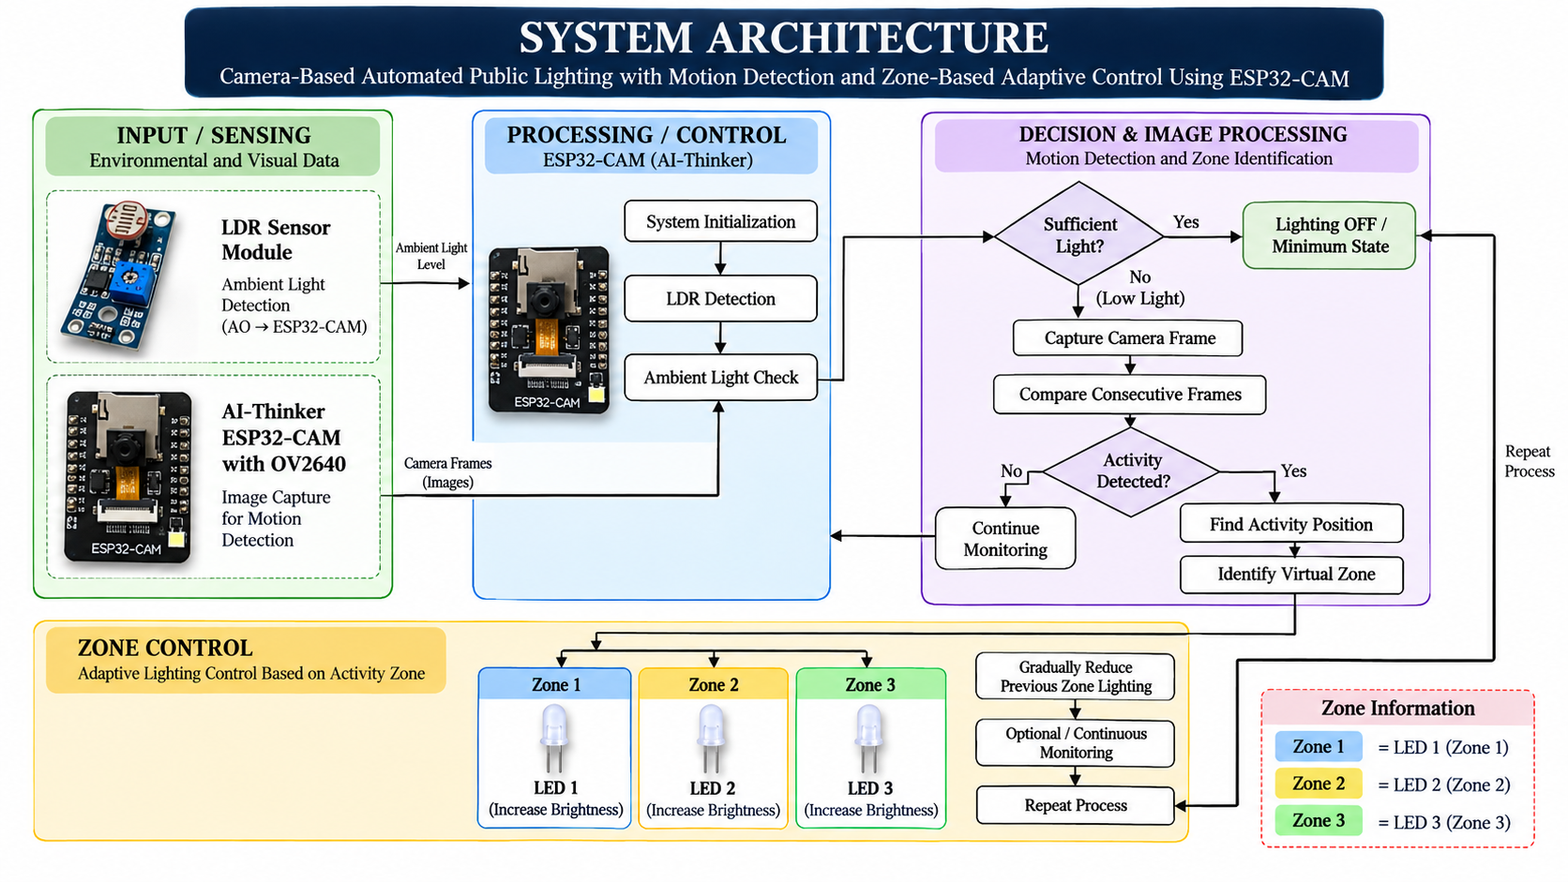
Architecture Diagram

Slide 11
Implementation Progress
Module | Status
ESP32-CAM initialization and frame capture | Completed
Three-zone adaptive LED control | Completed
Camera-based motion detection | Completed
LDR-based day/night detection | Not Completed
Firebase cloud integration | Not Completed
Complete system testing | Not Completed

Slide 12
Implementation Progress
ESP32-CAM configuration and OV2640 camera interfacing
Development of lightweight frame-differencing logic.
Division of the camera view into three virtual lighting zones.
Design of PWM-based LED brightness control.
Integration of LDR sensing and optional Firebase monitoring

Slide 13
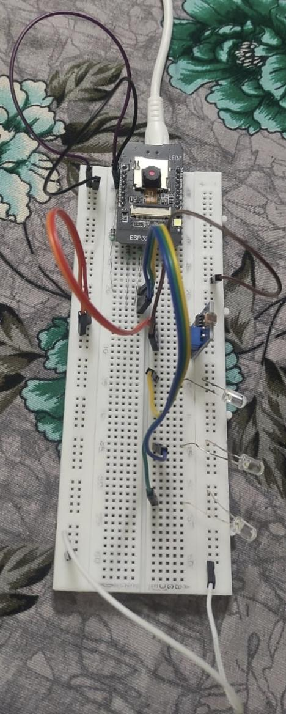
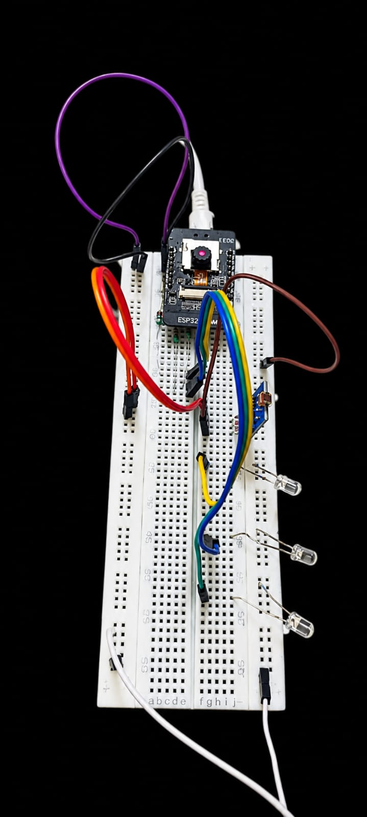
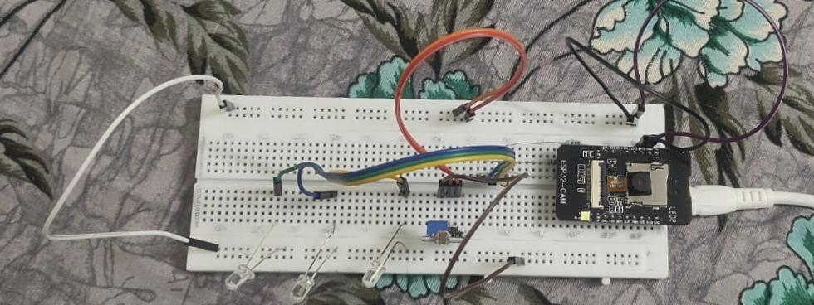
Implementation Progress

Slide 14
Individual Contribution
Student | Modules / Tasks | Work Completed
Murali M Naik | Research Paper and Software | Research paper preparation, software development and motion detection logic.
Tejas H M | Hardware and System Integration | Hardware setup, component connections and initial hardware-software system integration.
Mohith B E | Studied ESP32-CAM and Lighting Control | Studied ESP32-CAM, lighting control, zone mapping and assisted with testing

Slide 15
Github Link
https://github.com/<your-username>/Automated-Public-Lighting-System

Slide 16
Conclusion
The project aims to develop a low-cost, energy-efficient automated public lighting system using ESP32-CAM and motion detection.
The research paper, software development, hardware setup and initial system integration are currently in progress.
The proposed system uses camera-based motion detection, LDR sensing and three-zone adaptive lighting to reduce unnecessary energy consumption.
The next phase focuses on completing system integration, implementing cloud monitoring and testing the overall prototype.
Once completed, the system is expected to provide an intelligent and scalable solution for automated public lighting.

Slide 17
References (IEEE Paper format)
Add APA / IEEE citation for all references used in the Literature Review:
[1] [1] S. P. Lau, G. V. Merrett, A. S. Weddell, and N. M. White, “A traffic-aware street lighting scheme for Smart Cities using autonomous networked sensors,” Computers & Electrical Engineering, vol. 45, pp. 192–207, 2015, doi: 10.1016/j.compeleceng.2015.06.011.
[2] M. Mahoor, Z. S. Hosseini, A. Khodaei, A. Paaso, and D. Kushner, “State-of-the-art in smart streetlight systems: A review,” IET Smart Cities, vol. 2, no. 1, pp. 24–33, 2020, doi: 10.1049/iet-smc.2019.0029.
[3] A. Omar, S. AlMaeeni, H. Attia, M. Takruri, A. Altunaiji, M. Sanduleanu, R. Shubair, M. S. Ashhab, M. Al Ali, and G. Al Hebsi, “Smart City: Recent Advances in Intelligent Street Lighting Systems Based on IoT,” Journal of Sensors, vol. 2022, Art. no. 5249187, 2022, doi: 10.1155/2022/5249187.
[4] M. Takruri, K. P. Thulasingam, H. Attia, A. Omar, A. Altunaiji, S. Almaeeni, M. Sanduleanu, R. Shubair, M. S. Ashhab, M. Al Ali, and G. Al Hebsi, “Design and Implementation of a Real-Time Street Light Dimming System Based on a Hybrid Control Architecture,” International Journal of Distributed Sensor Networks, vol. 2023, Art. no. 6641563, 2023, doi: 10.1155/2023/6641563.
[5] S. Khemakhem and L. Krichen, “A comprehensive survey on an IoT-based smart public street lighting system application for smart cities,” Franklin Open, vol. 8, Art. no. 100142, 2024, doi: 10.1016/j.fraope.2024.100142.
[6] V. Križanović, K. Grgić, A. Pejković, and D. Žagar, “Energy Savings in Public Lighting by Using Adaptive Street Lighting—A Framework for Energy-Savings Assessment and Machine Learning-Based Evaluation,” Applied Sciences, vol. 16, no. 16, Art. no. 7917, 2026, doi: 10.3390/app16167917.
[7] S. D., V. Sagar K. S., and S. Sushmitha, “A Survey on IOT based Real Time, Smart Adaptive Street Lighting System with Pollution Monitoring for Smart Cities,” International Journal on Recent and Innovation Trends in Computing and Communication, vol. 7, no. 1, pp. 21–26, 2019, doi: 10.17762/ijritcc.v7i1.5221.
[8] T. E. Achar, C. Rekha, and J. Shreyas, “Smart automated highway lighting system using IoT: A survey,” International Journal of Electrical and Computer Engineering, 2024.
[9] A. F. Mohamed, A. A. Ali, A. Benmouna, H. Ramadan, and N. F. Omran, “IoT-Enabled Smart Street Lighting: A Bibliometric-Driven Review of Energy-Efficient Architectures and Environmental Integration,” Information, vol. 17, no. 6, Art. no. 596, 2026, doi: 10.3390/info17060596.
[10] S. Lau, G. Merrett, A. Weddell, and N. White, “Energy-efficient adaptive street lighting using networked sensing and intelligent control,” related work on traffic-aware adaptive street lighting, Computers & Electrical Engineering, 2015.

Slide 18


